Slide 1
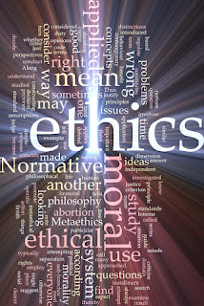
Management Information Systems: Managing the Digital Firm
Chapter 4
Ethical and Social Issues in Information Systems

Slide 2
Learning Objectives
4-1 What ethical, social, and political issues are raised by information systems?
4-2 What specific principles for conduct can be used to guide ethical decisions?
4-3 Why do contemporary information systems technology and the Internet pose challenges to the protection of individual privacy and intellectual property?
4-4 How have information systems affected laws for establishing accountability, liability, and the quality of everyday life?
Notes:
This chapter examines the ethical, social, and political issues raised by information systems. It can be useful to ask students to help you put together a list of these issues categorized into ethical, social, and political columns.

Slide 3
What Ethical, Social, and Political Issues Are Raised by Information Systems? (1 of 2)
Recent cases of failed ethical judgment in business
Volkswagen AG, Wells Fargo, General Motors, Takata Corporation
In many, information systems used to bury decisions from public scrutiny
Ethics
Refers to “the Principles of right and wrong that individuals, acting as free moral agents, use to make choices to guide their behaviors”
Notes:
There are numerous examples of business ethical failures to ask students about. You could ask how information systems or their absence might have been related to the recent financial crisis in the United States, the investment banks that have suffered heavy losses, and individuals who were able to defraud investors of millions. What role did IS have in this crisis? The Madoff Ponzi scheme is instructive: systems were used for more than twenty years to fool investors, regulators, and investigators about the true nature of Madoff’s business.

Slide 4
What Ethical, Social, and Political Issues Are Raised by Information Systems? (2 of 2)
Information systems raise new ethical questions because they create opportunities for:
Intense social change, threatening existing distributions of power, money, rights, and obligations
New kinds of crime

Slide 5
A Model for Thinking about Ethical, Social, and Political Issues.
Society as a calm pond
IT as rock dropped in pond, creating ripples of new situations not covered by old rules
Social (family, education, organization) and political institutions cannot respond overnight to these ripples—it may take years to develop etiquette, expectations, laws
Requires understanding of ethics to make choices in legally gray areas (in the meantime)
Notes:
Can students provide any examples of how IT has challenged some area of ethics, social life, or legal arrangements?

Slide 6
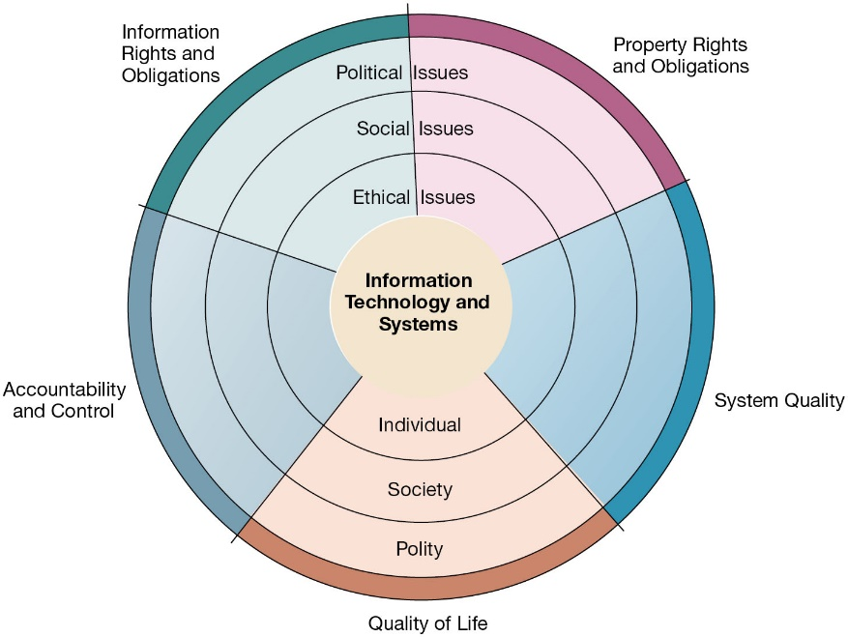
The Relationship Between Ethical, Social, and Political Issues in an Information Society
Notes:
Figure 4.1, Page 127.
The introduction of new information technology has a ripple effect, raising new ethical, social, and political issues that must be dealt with on the individual, social, and political levels. These issues have five moral dimensions: information rights and obligations, property rights and obligations, system quality, quality of life, and accountability and control.
Explain to students that the graphic displays the five moral dimensions listed in the caption. Consider online P2P bit torrent shared music as an example of how a new technology has ethical, social, and eventually political (legal) ramifications. If music can be ripped off, why pay any money for it? Why should anyone care about record labels or artist’s income?

Slide 7
Five Moral Dimensions of the Information Age
Information rights and obligations (individual and organizations)
Property rights and obligations (intellectual property rights in a digital society)
Accountability and control (who is accountable for the harm done to individual, information and property rights)
System quality (what standards of data and system quality we should demand to protect individual rights and the safety of society?)
Quality of life (values preserved in the society, which institute we should protect? Cultural values and practices supported by the IT)

Slide 8
Key Technology Trends that Raise Ethical Issues
Computing power doubles every 18 months (more organizations depend on computer systems)
Data storage costs rapidly decline (multiplying databases)
Data analysis advances
Networking advances (including internet)
Mobile device growth impact: A total of 2.10 million cellular mobile connections were active in Bahrain in early 2023, equivalent to 142.1 percent of the total population. https://datareportal.com/reports/digital-2023-bahrain
Notes:
Do you think these are good? Or Bad? Why?

Slide 9
Advances in Data Analysis Techniques
Profiling
Combining data from multiple sources to create dossiers of detailed information on individuals
Nonobvious relationship awareness (NORA)
Combining data from multiple sources to find obscure hidden connections that might help identify criminals or terrorists
For example,
an applicant for a job at a company shares a telephone number with a known criminal and as such issue an alert to the hiring manager.
Airline company identifying potential terrorists attempting to board a plane.
Government identifying potential terrorists by monitoring phone calls.

Slide 10
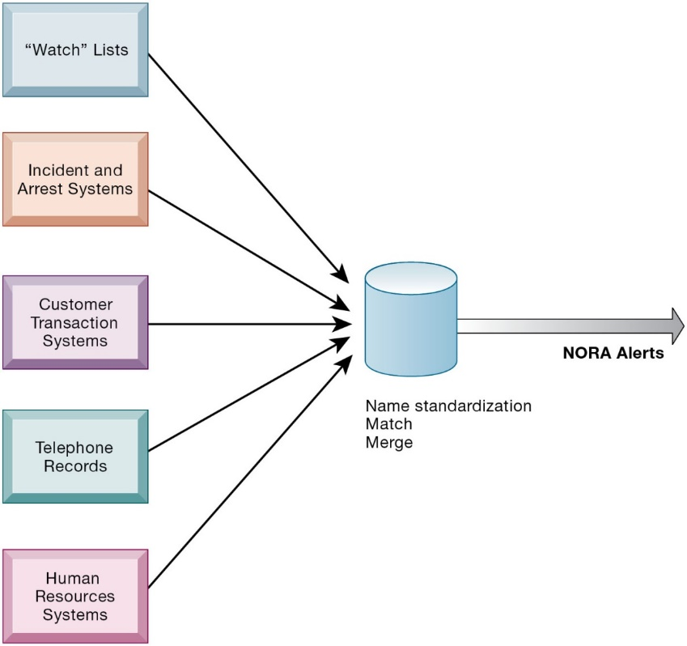
Nonobvious Relationship Awareness (NORA)
Notes:
Figure 4.2, Page 131
NORA technology can take information about people from disparate sources and find obscure, nonobvious relationships. It might discover, for example, that an applicant for a job at a casino shares a telephone number with a known criminal and issue an alert to the hiring manager.
Explain that NORA is used by both the government and the private sector for its profiling capabilities. Ask students to provide potential examples of NORA (other than the one mentioned in the caption) for both governmental and business purposes. One such example might be an airline identifying potential terrorists attempting to board a plane. Another might be government identifying potential terrorists by monitoring phone calls.

Slide 11
Basic Concepts: Responsibility, Accountability, and Liability (consequences)
What specific principles for conduct can be used to guide ethical decisions?
Responsibility
Accepting the potential costs, duties, and obligations for decisions made by individuals
Accountability
Mechanisms for identifying responsible parties
Liability
Permits individuals (and firms) to recover damages done to them
Due process
Laws are well-known and understood, with an ability to appeal to higher authorities
Notes:
Explain that information systems do not exist in a vacuum and that these concepts are instrumental in understanding the impact of systems and measuring their success. Ask students why liability and due process are such important ethical concepts? (A rough answer would be that they provide recourse to individuals negatively effected by mismanagement of information systems, providing incentive to “play by the rules”.)

Slide 12
Ethical Analysis
Five-step process for ethical analysis
Identify and clearly describe the facts.
Define the conflict or dilemma and identify the higher-order values involved.
Identify the stakeholders.
Identify the options that you can reasonably take.
Identify the potential consequences of your options.
Notes:
Do students believe that any aspect of ethical analysis is lacking from this process? If so, what? Can students offer a brief example of an ethical dilemma and how they would resolve it using this process? One class exercise is to work with students to identify an ethical situation they are aware of, or that may have been in the news. Then, go through the ethical analysis described in the slide to illustrate the process of analyzing an ethical situation.

Slide 13
Candidate Ethical Principles (1 of 2)
Golden Rule
Do unto others as you would have them do unto you (treat others as you want others to treat you)
Immanuel Kant’s Categorical Imperative
If an action is not right for everyone to take, it is not right for anyone
Slippery Slope Rule
If an action cannot be taken repeatedly, it is not right to take at all

Slide 14
Candidate Ethical Principles (2 of 2)
Utilitarian Principle
Take the action that achieves the higher or greater value
Risk Aversion Principle
Take the action that produces the least harm or potential cost
Ethical “No Free Lunch” Rule
Assume that virtually all tangible and intangible objects are owned by someone unless there is a specific declaration otherwise

Slide 15
Professional Codes of Conduct
Promulgated by associations of professionals
American Medical Association (AMA)
American Bar Association (ABA)
Association for Computing Machinery (ACM)
Promises by professions to regulate themselves in the general interest of society

Slide 16
Real-world Ethical Dilemmas
One set of interests pitted against another
Examples
Monitoring employees: Right of company to maximize productivity of workers versus workers right to use Internet for short personal tasks
Facebook provides useful services for users but monitors user behavior and sells information to advertisers and app developers
Notes:
Other ethical dilemmas include companies trying to use new systems to reduce the size of their workforce, such as telephone companies using automated systems to reduce the need for human operators. Emphasize that in cases like these, right and wrong are not clearly defined, but instead, contrasting values are at odds with one another (companies value productivity, employees value their work).

Slide 17
Information Rights: Privacy and Freedom in the Internet Age
Privacy
Claim of individuals to be left alone, free from surveillance or interference from other individuals, organizations, or state; claim to be able to control information about yourself
Personal Data Protection Law (PDPL) of 2018: This is Bahrain's primary legislation for the protection of personal data and privacy. It regulates the processing of personal data, ensuring that individuals' data is handled securely and with respect for their privacy rights. regulations.pdf (pdp.gov.bh)
Notes:
Do students believe that there are sufficient protections for privacy in law? If not, what are possible methods of developing appropriate privacy protections? Table 4-3 in the text lists a variety of other laws affecting both the government and private institutions, but few areas of the private sector are as well regulated with respect to privacy. Do an in-class poll and ask students who among them feel they can control the use of their personal information on the Internet. You should get no one raising their hand.

Slide 18
EU General Data Protection Regulation (G D P R)
Requires unambiguous explicit informed consent of customer
E U member nations cannot transfer personal data to countries without similar privacy protection
Applies across all E U countries to any firms operating in E U or processing data on E U citizens or residents
Strengthens right to be forgotten
Privacy Shield: All countries processing E U data must conform to G D P R requirements
Heavy fines: 4% of global daily revenue

Slide 19
Internet Challenges to Privacy (1 of 2)
Cookies (small text files deposited on computer hard drive when user visits website)
Identify browser and track visits to site
Web beacons (web bugs or tracking files)
Tiny graphics embedded in e-mails and web pages
Monitor who is reading e-mail message or visiting site (monitor online behavior)
Spyware
Surreptitiously installed on user’s computer
May transmit user’s keystrokes or display unwanted ads
Google services and behavioral targeting:
Tracking and analyzing user behavior to serve personalized ads, raising concerns about how personal data is collected and used.

Slide 20
Internet Challenges to Privacy (2 of 2)
The United States allows businesses to gather transaction information and use this for other marketing purposes (without user’s approval)
Opt-out vs. opt-in model
The opt-out model automatically includes users in data collection or subscriptions and requires them to actively choose to leave,
while the opt-in model requires users to actively choose to participate or subscribe.

Slide 21
Technical Solutions (to protect user privacy during interactions with websites)
Solutions include:
E-mail encryption
Anonymity tools
Anti-spyware tools
Overall, technical solutions have failed to protect users from being tracked from one site to another
Browser features
“Private” browsing - privacy feature in some web browsers to disable browsing history and the web cache. This allows a person to browse the Web without storing local data that could be retrieved at a later date. Example: Incognito mode.
“Do not track” options - let you tell every website you visit, their advertisers, and content providers that you don't want your browsing behavior tracked.

Slide 22
Property Rights: Intellectual Property
Intellectual property
Intangible property of any kind created by individuals or corporations
Four main ways that intellectual property is protected:
Trade secret: intellectual work or product belonging to business (not based on the information in the public domain) i.e. formula, device, pattern
Copyright: statutory grant protecting intellectual property from being copied for the life of the author, plus 70 years
Patents: grants creator of invention an exclusive monopoly on ideas behind invention for 20 years
Trademarks

Slide 23
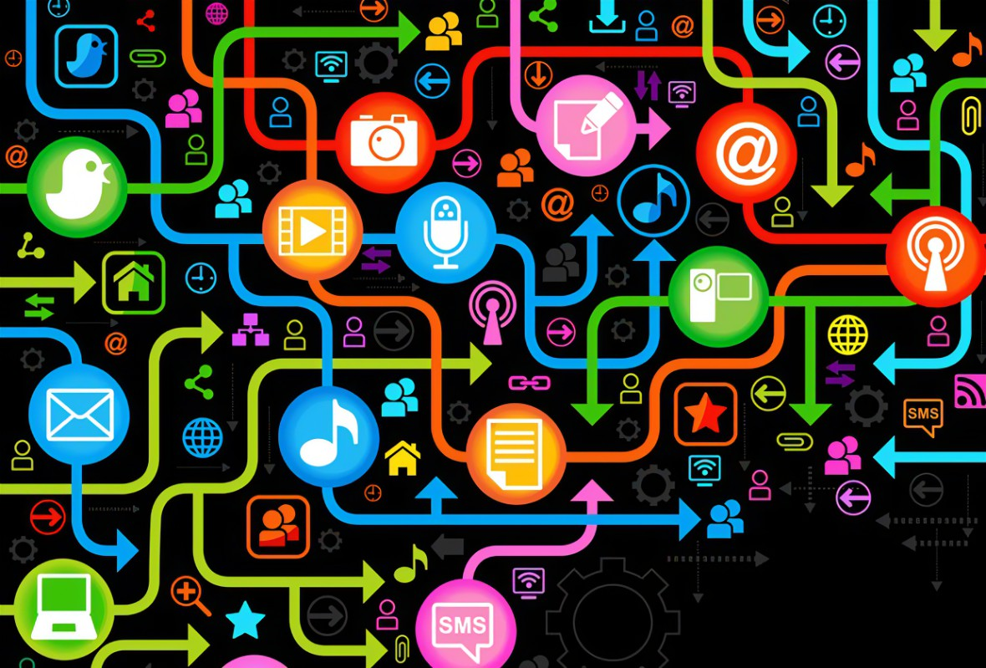
Challenges to Intellectual Property Rights
Digital media different from physical media
Ease of replication
Ease of transmission (networks, Internet)
Ease of alteration
Compactness
Difficulties in establishing uniqueness

Slide 24

Computer-Related Liability Problems
If software fails, who is responsible?
If seen as part of a machine that injures or harms, software producer and operator may be liable.
If seen as similar to book, difficult to hold author/publisher responsible.
If seen as a service? Would this be similar to telephone systems not being liable for transmitted messages?

Slide 25
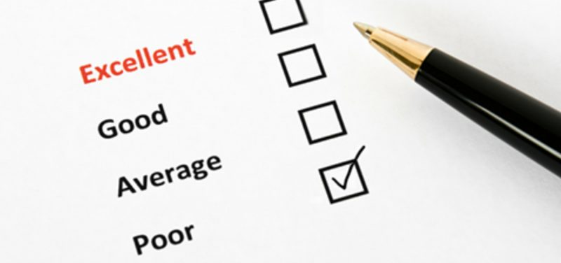
System Quality: Data Quality and System Errors
What is an acceptable, technologically feasible level of system quality?
Flawless software (perfect) is economically unfeasible (high cost and no one then can not afford it)
Three principal sources of poor system performance
Software bugs, errors
Hardware or facility failures
Poor input data quality (most common source of business system failure)
Notes:
Do students have any opinion about when software is “good enough?” Does it depend on the particular product? For example, distinguish between software used by air traffic controllers and software used for word processing. Do students believe that there are different levels of acceptable quality for these products?

Slide 26
Quality of Life: Equity, Access, Boundaries (1 of 3)
Negative social consequences of systems:
Rapidity of change: reduced response time to competition not enough time to respond to global competitors (lead to loose your business and job)
Maintaining boundaries: family, work, and leisure (i.e. do anything anywhere anytime)
Dependence and vulnerability (all depend on IS and as such they are vulnerable to system fails)
Computer crime and abuse (i.e. spam)
Notes:
Ask students whether they have witnessed any of these negative consequences first hand. It's likely that they know someone who has become dependent on their computer to some extent or have even experienced something similar first hand. Which of the above consequences do students feel is the most alarming?

Slide 27
Quality of Life: Equity, Access, Boundaries (2 of 3)
Computer crime and abuse
Computer crime
Computer abuse
Spam
CAN-SPAM Act of 2003 (require commercial messages to display accurate subject lines, identify the true senders and offer recipients an easy way to remove their names from email lists)
Employment (i.e. end result of continuing advances in information technology will be rising unemployment and a small number of elite corporate professionals)
Trickle-down technology (i.e. AI, IoT, robotics…etc)
Reengineering job loss

Slide 28
Quality of Life: Equity, Access, Boundaries (3 of 3)
Equity and access
The digital divide (does everyone has an equal opportunity to participate in the digital age?)
Health risks
Repetitive stress injury (RSI)
Carpal tunnel syndrome (CTS)
Computer vision syndrome (CVS)
Technostress

